Slide 1
Laser Cat
Presented by:
Almeda Glenn Brandon Tan Troy Toh Lim Wei Heng

Slide 2
Overview
Gameplay Samples
Screenshots (Before & After)
Reviews(?)
Risks/Concerns
Random Inspirations
Q&A

Slide 3
Gameplay Samples

Slide 4
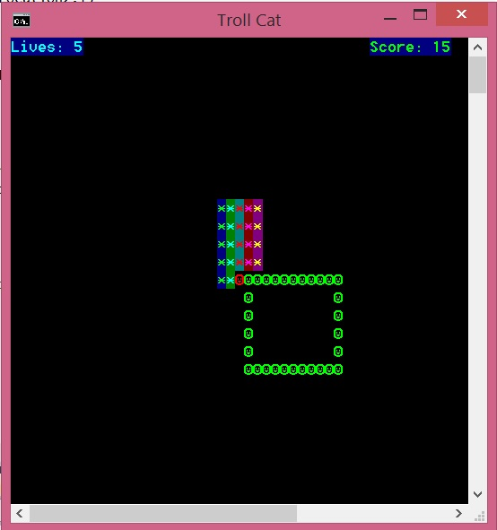
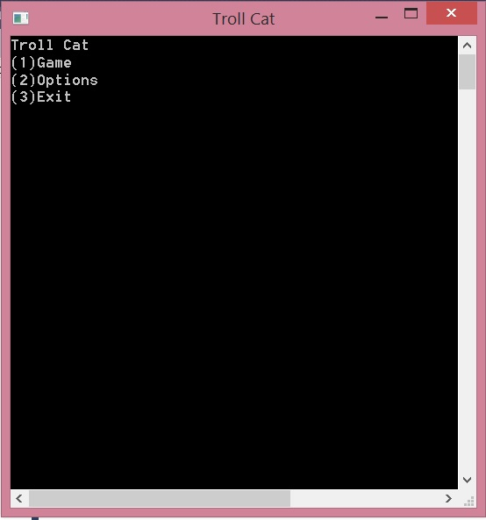
Screenshots (Before)
Initial Menu →
← Initial Gameplay

Slide 5
Screenshots (After)
//final product of the game

Slide 6
Risks/Problems/Concerns
//to brainstorm some potential issues we are aware of….

Slide 7
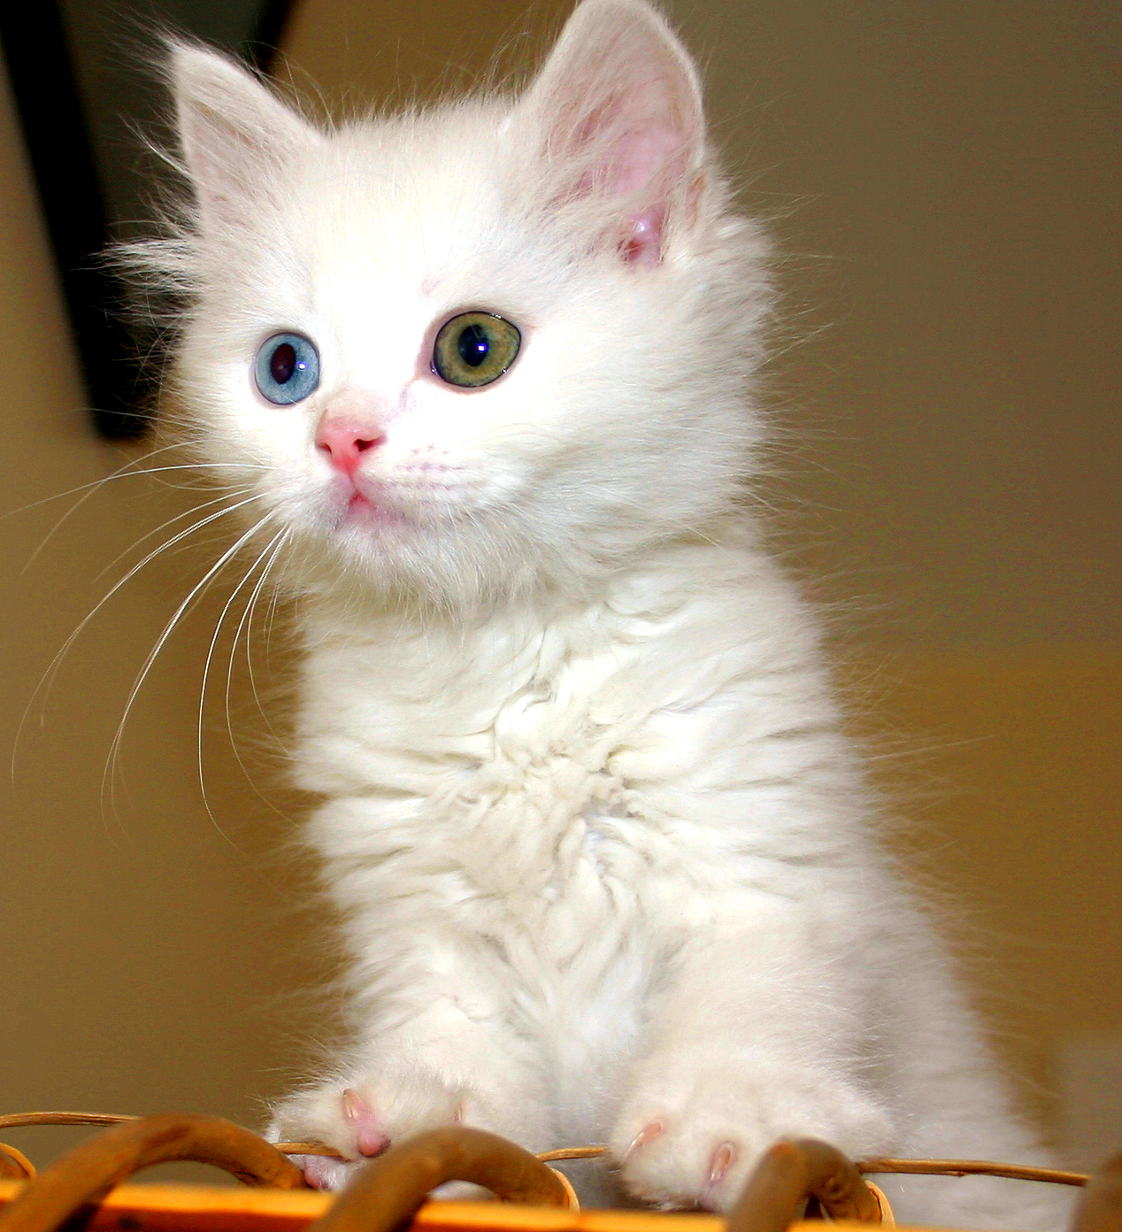
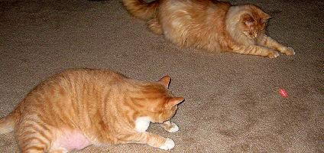
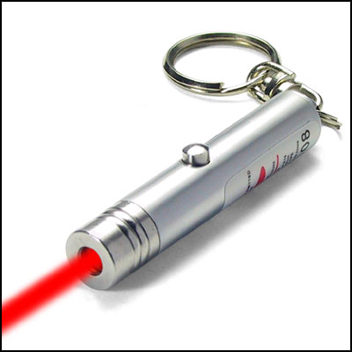
Inspirations

Slide 8
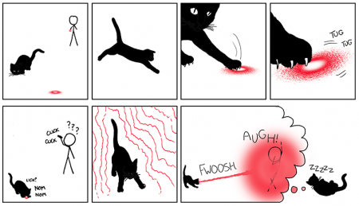
Inspirations

Slide 9
Thank You!!

